Slide 1
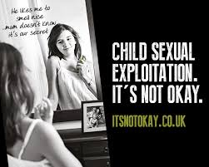
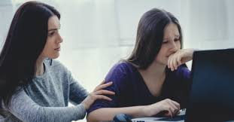
Keeping Kids Safe Online
Vanessa McFarlane
Nottingham Citycare Partnership

Slide 2
What are your concerns??
Cyberbullying
Pornorgraphy
Sharing indecent images
Talking to /meeting strangers
Time spent online

Slide 3
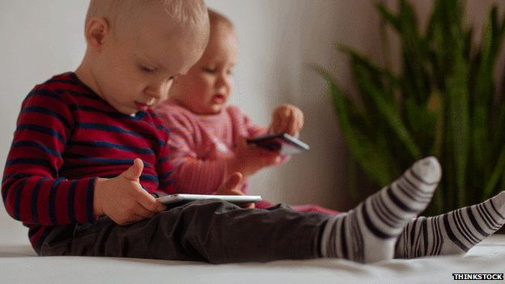
Stats: Internet Use by Children and Young People
3-4 yrs: 1% smartphone 21% tablet
8-11yrs: 39% smartphone 52% tablet
12-15yrs: 83% smartphone 55% tablet
23% 8-11yrs and 74% 12-15yr had Social Media profile
All ages groups watch TV for 13-15 hrs per week
YouTube viewing has increased across all ages e.g 71% of 5-7yr olds
99% of 12 – 15yr are online 21hrs per week
(OFCOM 2017)
Notes:
Most kids watch Tv via catch up and other providers such as Netflix

Slide 4
PARENTS’ Online Behaviour
95% of UK parents post pictures of their
children online.
51% of parents who use Facebook to post about
their children – they haven’t thought about the
embarrassment it might cause in later life
More than ¾ of parents have spoken to their
children about internet safety … but are we leaving
this too late?
Notes:
surveyed by print site Posterista
Kids have said they felt uncomfortable when parents share pics and vids of them online without their permission , they don’t like lots of people to see some pics or feel embarrassed and feel they don’t have control over what is shared
When younger children use parents phone and can access FB/insta/snap they may see things that arent appropriate as they are using an adults account

Slide 5
Cyberbullying
Cyberbullying is bullying that takes place online. Unlike bullying in the real world, online bullying can follow the child wherever they go, via social networks, gaming and mobile phone. (NSPCC)
Different types of Cyberbullying including
Harrassment
Impersonation
Outing /Trickery
Exclusion

Slide 6
Notes:
https://social-media.co.uk/list-popular-social-networking-websites
From top left
Live.ly
Youtube
Pintrest
Musical.ly
Live.me
Periscope
Snapchat
Tinder
Houseparty
Instagram
WhatApp
Twitter
Kids youtube
Yellow
Roblox
Facebook
Kiddle – kids google
Oovoo
FB Messenger
Live Streaming Apps such as Live.ly, Live.me and Periscope are now causing concern all have had cases of adults contacting children via the apps. Police in UK have been involved in cases with live streaming sites
Periscope is owned by Twitter
Live.ly was created by Musical.ly
Live.Me – fastest growing live streaming app, over 20m users, security is low, man was recently convicted, he was encouraging a 9 yr old child to expose her self, this was then seen by 300 people before being taken down
Yellow is dubbed Tinder for Teens and works similarly to tinder but connects anyone the user likes to their SnapChat. SnapCHat has maps which can locate a person so you then have potentially strangers who can locate you
Youtube kids and Kiddle are good to get young ones started and filter any inappropriate information
Insta and Snap are the most popular apps with teens
Houseparty new vid sharing platform where you can talk to a number of people at same time
Roblox – new online gaming app popular with primary age particularly Yr 4 and 5
Throughout the online gaming world, wherever games are marketed to children, online predators lurk. Social games like this are often used as a platform to lure children away from the game and onto other platforms: eg., Facebook, Snapchat and even in some cases Skype. Roblox appeals directly children under 12, easy targets who lack the ability to discriminate between appropriate and inappropriate requests.
The game invites players to explore imaginary worlds of all kinds. Some of these are sexual in nature. One British dad who decided to check out the game his sons were obsessed with was shocked to discover avatars having virtual sex, ABC News reported in 2017.
"The chat function poses a real danger to children playing this popular game," explains ySafe psychologist Jordan Foster, a leading Cyber Expert at Family Zone. "With limited safety measures embedded within the game, children are open prey for predators to communicate with.
If looking at the most used form of Social media generally its still FaceBook

Slide 7
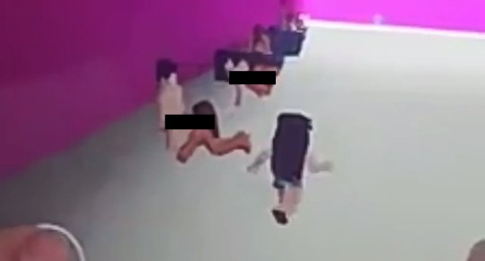
Roblox Inappropriate Room

Slide 8
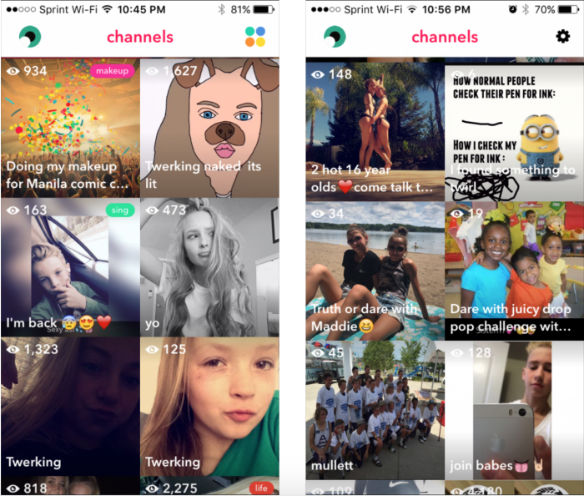
Notes:
This is an snapshot exampe of live streaming content - can see some are young children and some of the text is sexual

Slide 9
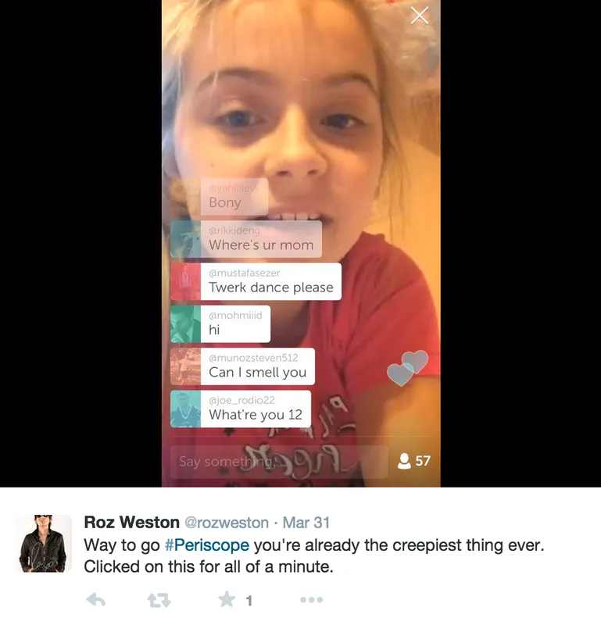

Slide 10
Sharing Indecent Images
Is it illegal to show someone or share with someone else an indecent image of someone U 18 ?
Is it illegal for U18s to share images of themselves to other U18s?
Is it illegal for an adult to ask a child to share indecent image or video?
Is it your choice to share indecent images of yourself even if you are under 18?
Are indecent images of children easy to get taken down?

Slide 11
Grooming children & Young People
Grooming is when someone tricks a young person into thinking they are special or in a relationship with the intention of sexually exploiting them in the future. They often gain a young person’s trust through giving presents, emotional support or food.

Slide 12
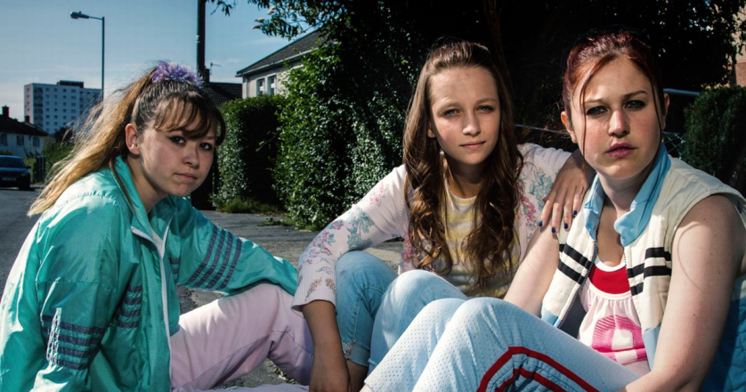
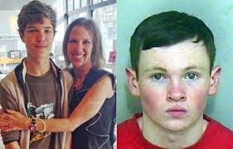
Ways Children are Exploited
Boyfriend
Groups/organised
Party
Peer Exploitation
Internet/SNS
Inappropriate Relationship
Gangs
Notes:
Inappropriate relationships – power imbalance
Often seen with a female perpertrator. Research from schools found 450 accusations made against school staff and an additional 450 allegations of inappropriate behaviours.
High proportion of offenders are women - 43% of all cases of SA in schools and the victims were male
Where there is power imbalance
Abuse of a position of trust Football Disclosure case
Peer on Peer
Increased cases where all of those involved are U 18.
This includes sexuall bullying, coercion to send images, physical and sexual assaults, CSE and teen relationship abuse and abuse in gangs.
The YP involved are from same schools or neighbourhoods.
YP may experience multiple forms of abuse and be involved in grooming other peers
1/4 cases are peer on peer (2011)
Lots of new research into the increase of abuse in teen relationships
8 of Barnardo’s CSE services have reported an increase in exploitation by peers. (Barnardo’s 2012).
29% of perpetrators reported to the Inquiry* during Phase 1, were under the age of 19, and the youngest was 12. (* Office of the Children’s Commissioner Inquiry. Final report).
Sometimes referred to in schools as ‘sexual bullying’. May involve several groups sexually assaulting and harassing a victim routinely over an extended period. (Rapid evidence assessment)
1:3 girls experience sexual abuse in a relationship (NSPCC)
Girl A (Rochdale) was controlled by a peer for 2yrs
Gang
Why would a young woman join a gang? Belonging..kudos.. Lifestyle…status..money…power..respect..percieved protection..grooming
Girls are more likely to recognise the SE but still as something they have to do, boys see it as part of being in the gang
Gang expolitation is linked to status, drugs, money and protections
Rape of young women assoc with rival gangs.
Female gang members may exploit male members for status
Male members can be the victim sexually – as a way to humiliate or in that they are coerced to be involved in the abuse – so can be perp and victim at the same time
Perpetrators of CSE within gangs were mainly men and boys aged between 13 and 25 who took part in many forms of criminal activity in addition to sexual exploitation, including robbery and knife crime.
Research suggests a willingness for abusers from ethnic backgrounds to work in gangs rather than alone.
YP do not report- normalisation of sexual violence, risk of retribution, lack of confidence in services to help
Organised Group
Come together in person or online for purpose of CSE
Either organised or opportunistic
May never meet or may be connected through the victims they abuse
Party
Can be part of the other models ie Group, gang or could be set up by perpertrator where groups of young people are invited so there is safety element there
Free alcolhol drugs etc . Perpetrator has a number of young people to select and grooming and exploitation takes place
Boyfriend
Can work alone or as part of group or gang model. Common in big cases
Can groom and exploit a child or young person on their own via internet or in real time
Groups will use younger boys to groom girls and then introduce them to the lead person who then exploits them

Slide 13
What is the impact? Research
Porn: has some influence on their expectations when it comes to sex
Sleep and exercise routines could be a concern – it about getting a balance
Mental health – some research around the impact of SM on mental health but seems to affect girls more so
Cyberbullying can have ongoing impact on self esteem, depression etc

Slide 14
NSPCC Guide to Social Media and Gaming (Netaware)
Among the most common signs to watch out for include children who:
Become very secretive, especially about what they are doing online
Are spending a lot of time on the internet and social media
Are switching screens on their device when approached
Are withdrawn or angry after using the internet or sending text messages
Have lots of new phone numbers or email addresses on their devices

Slide 15
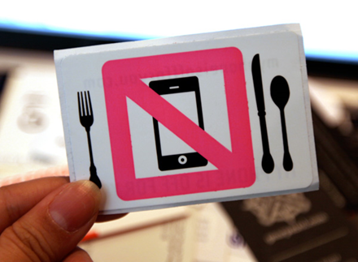
So what do we do?
Keep communication open – even with difficult topics
Be aware of apps they are using an get involved.
Talk about what they understand in relation to keeping themselves safe
Online Reputation and having a positive digital footprint
Dealing with pressure online
If you can establish time limits or no phone time eg: bed time, at the table, notifications off
Role Modelling
Use the internet for support
Ping

Slide 16
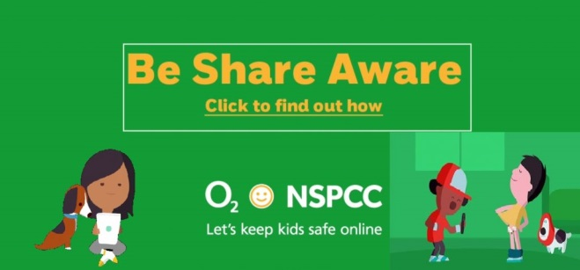
Where to Help and Support
https://www.net-aware.org.uk/
www.nspcc..org.uk
www.bullying.co.uk
www.childline.org.uk
www.Thinkuknow.co.uk

