Slide 1
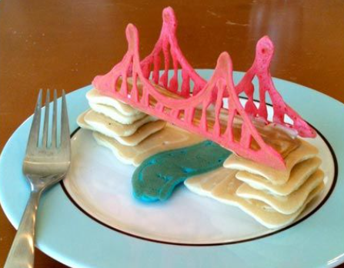
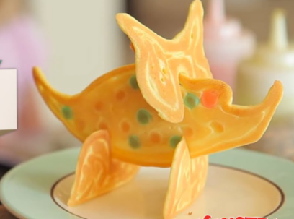
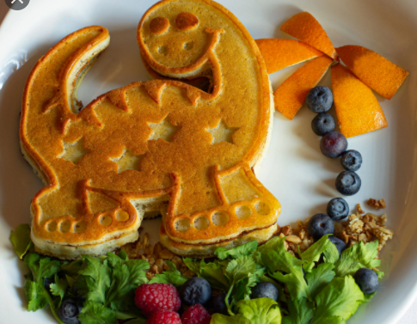
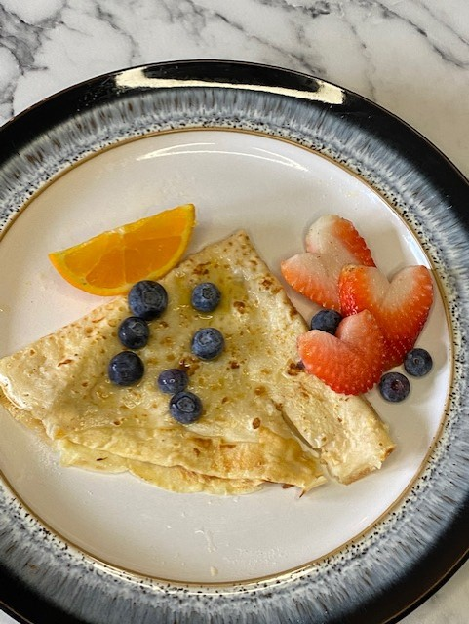
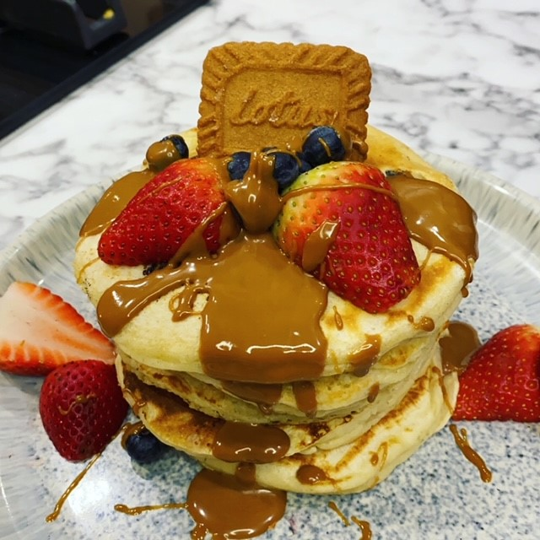
Miss Bird’s Pancake Challenge With pancake day coming up on Tuesday 16th February I challenge you to design and make your best ever pancakes! Sketch your design first and annotate, make a list of any extra ingredients you will use. It might be a stack that’s decorated or you might change the traditional round shape of the pancake with a design of your own. CHALLENGE Can you add any fruit to make them heathy? Can you produce a recipe card to show someone else how to make them? Email entries to: lbird@emmanuel.nottingham.sch.uk Please specify your name and year group in the response and whether you are happy to have your photo and name shared. (The winners will be shared on the school’s Twitter and Instagram accounts.) There will be one winner per year group announced Friday 26th February.

Slide 2
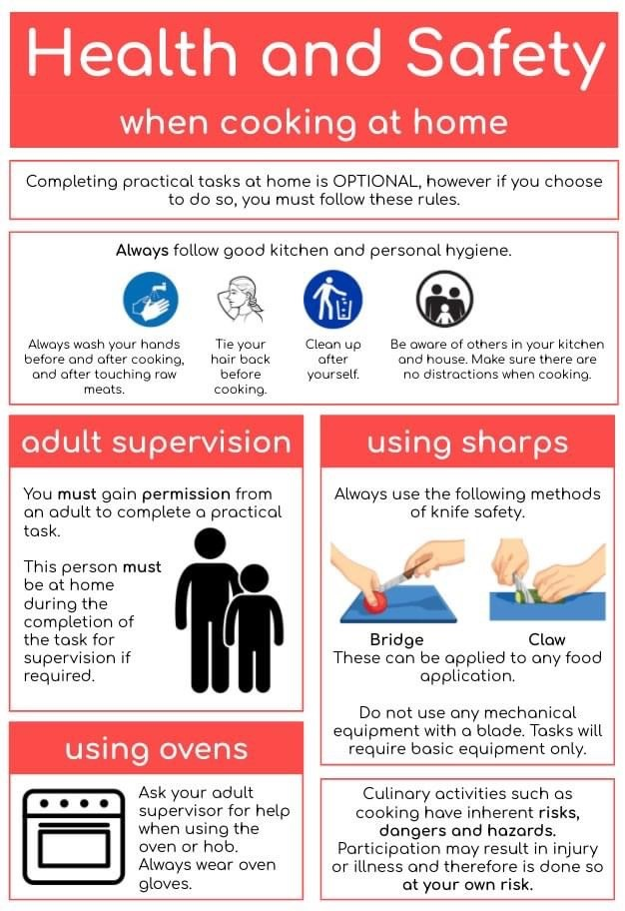

Slide 3
When is Pancake day? Tuesday, February 16. What is pancake day?
Shrove Tuesday is the Christian Holy Day that occurs just before Ash Wednesday which marks the first day of Lent - the, traditionally, 40 days of penitence before Easter.
To prepare for Lent, on Shrove Tuesday, many Christians participate in confession to be absolved from their sins, and take the day to feast before their Lenten fast.
Shrove Tuesday was the last day Christians had to use up their fresh produce like eggs and fats - and pancakes were the ideal recipe to up all of these ingredients that would otherwise spoil.

Slide 4
Traditional Pancakes
METHOD:
Sieve your flour into a mixing bowl.
Crack eggs into a mug/jug and add to your flour. Use a whisk to make a thick paste.
Now pour in milk a little at a time and whisk – this will be around the consistency of single cream.
Use a non stick frying pan and put it on the hob. Add around 1 tsp of oil.
Test the oil to see if it is hot enough by adding a drip of the batter. To tell it is done you should hear and see it sizzling.
Pour in enough mixture to cover around half the pan, then tilt the frying pan so the batter covers all of the base. This wants to be quite thin else you will have a stodgy pancake.
Allow to fry for around a minute then turn over and fry the other side.
Ingredients
100g plain flour
2 large eggs
300ml milk
Oil to cook your pancakes in.

Slide 5
American Style Pancakes
Ingredients:
200g self-raising flour
1 tsp baking powder
1 egg
300ml milk
Tbsp. of butter
Oil to cook in
Optional extras – frozen/fresh blueberries
Method
Sieve 200g self-raising flour, 1 tsp baking powder and a pinch of salt into a mixing bowl.
Beat 1 egg with 300ml milk, make a well in the centre of the dry ingredients and whisk in the milk to make a thick smooth batter.
Beat in a tablespoon of melted butter.
Put a non stick frying pan on the heat. Add butter or sunflower/vegetable oil.
Drop a small amounts of the batter to the pan to make pancakes about 8cm across. Make three or four pancakes at a time.
Once you have the batter in drop your blueberries onto your batter.
Cook for about 3 minutes over a medium heat until you see the edges of the pancake start to dry out. Then turn and cook another 2-3 minutes until golden.

Slide 6
Pancake Competition
Full Name
Year group/Tutor Group
Design Ideas
Photo of my pancake
Ingredients used
Method

