Slide 1
Curriculum Choices Evening
Tuesday 1st March 2022
Mrs Stapleton - Principal
Mr Wright - Assistant Principal
Mr Barrow - Year Leader for Year 8

Slide 2
Welcome
Welcome to a pivotal evening for every Year 8 student at Nottingham Emmanuel School.
The GCSE years are a vital part of every students education and they lay the foundations for further study within the Sixth Form or alternatively the stepping stones towards an apprenticeship or further training.

Slide 3
NES Curriculum Offer:
‘live life in all its fullness’
“The curriculum is ambitious and designed to give all pupils, including disadvantaged pupils and those with special educational needs and/or disabilities (SEND), the knowledge they need to succeed”
OFSTED, March 2020

Slide 4
The Year 9 Curriculum
All pupils will continue studying all their current subjects.
Pupils will make a preference now for one of the EBACC subjects (in green) to continue onto GCSEs.
The one they choose now, they will have 3 lessons each week, the other two will have 2 lessons each week.
The main options process will take place this time next year.
English
Maths
Science
RS
PE
CORE
DT
IT
Art
Music
Drama
French
Or
Spanish
Geography
History
Options
Notes:
Triple science
Some students take further maths
Some will take an exam in their own language

Slide 5
What are ‘Ebacc subjects’?
History Geography French/Spanish
The government recommends students take at least one of these subjects.
You will put all these subjects in order of most preferred to least preferred.
If you want to go to a top (Russell Group) university, we would suggest you take History or Geography and a language.

Slide 6
Why are we changing the key stage length?
Develop knowledge and understanding
Broaden skills for GCSEs
Broaden the curriculum for pupils
Improve the life chances of pupils

Slide 7
NES Curriculum Choices Process

Slide 8
Subject Information
In the Curriculum Choices booklet, each subject has an information page where you can find:
Information about the course and skills that you will need or develop
A brief overview on how you will be assessed (e.g. written exam, non-exam assessment, practical exam etc.)
Contact details for the teacher who can answer any questions you have about the subject

Slide 9
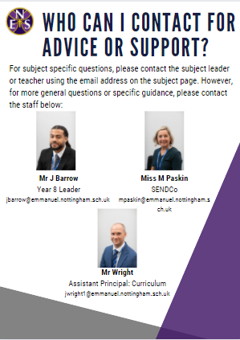
Making the Right Decisions for YOU
Students can get advice from lots of places:
Parents
Mr Barrow
Mr Wright
Miss Paskin/Learning Support Keyworker
Subject Teacher/Head of Department
Your Tutor
After the deadline of Friday 11th March 3pm, we will be reviewing the choices made. We will be in contact if we need to discuss your choices further.

Slide 10
Making the Right Decisions
Some advice:
DO ✓
Choose subjects that you like and are excited about.
Choose subjects you are doing well in.
Listen to advice from your teachers, Year Leader or keyworker.
DON’T ✗
Choose subjects just because your friends are choosing it.
Choose a subject because you like or don’t like a certain teacher. They might not end up teaching you!

Slide 11
Key Dates
In the chapel you will find stalls with further information about the EBACC subjects along with examples of students work and staff to ask questions to.

Slide 12
Any Questions?

