Slide 1
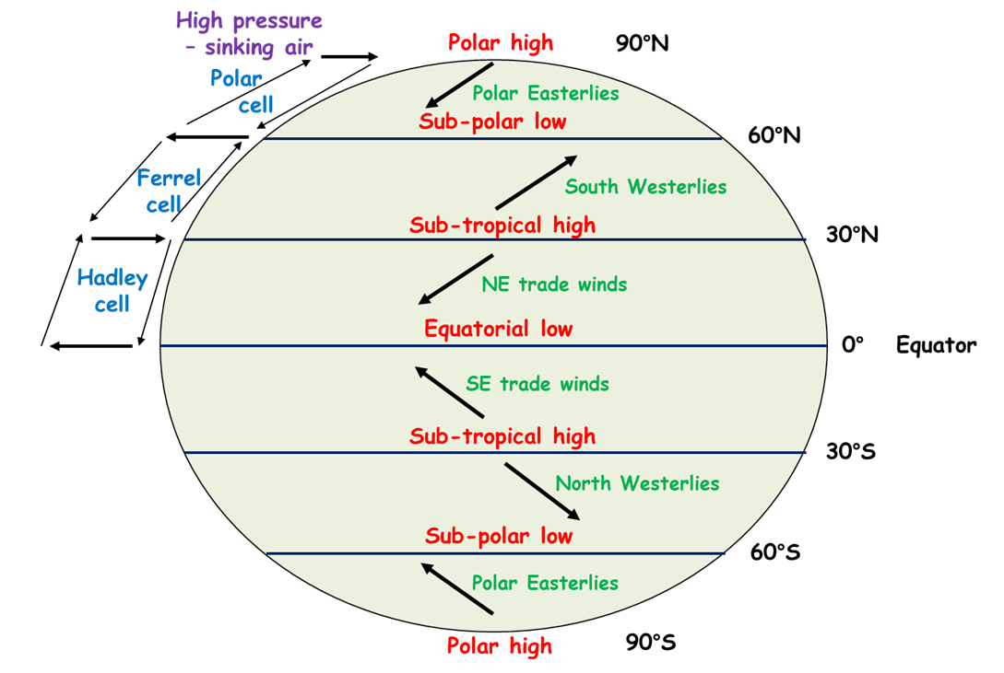
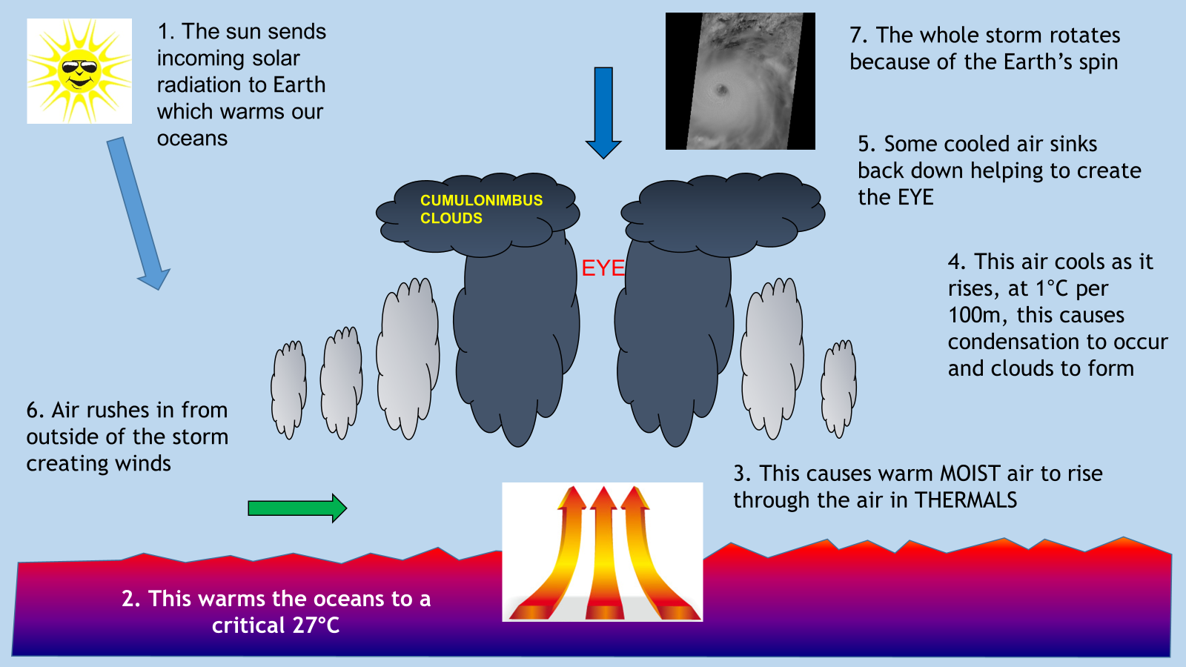
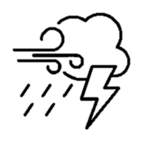
Geography – Year 10 – Weather Hazards
BBA
Section 1: Core Vocabulary
Vocabulary | Definition | Image
Natural hazards | Extreme natural events that can cause loss of life, extreme damage to property and disrupt human activities.
High pressure | Sinking air, associated with dry conditions.
Low pressure | Rising air, associated with wet conditions.
Tropical storms | An area of low pressure with strong spiral winds and heavy rainfall. Known as a hurricane, cyclone or typhoon.
Primary effects | The immediate effects of a natural hazard, for example, collapsing buildings.
Secondary effects | The knock-on effects of a natural hazard, for example, homelessness.
Immediate responses | Reaction of individuals, countries and organisations as a disaster happens and in the immediate aftermath, e.g. providing aid.
Long-term responses | Later reactions that occur in the weeks, months and years after the event, e.g. rebuilding.
Climate change | How the average climatic conditions of the planet vary over time.
Extreme weather | When a weather event is significantly different from the average or usual weather pattern and is especially severe or unseasonable .
Section 2: Key Knowledge
Global atmospheric circulation model Global atmospheric circulation is a simplified version of how air moves across the planet. It is used to help explain weather patterns and climatic regions. Structure of a tropical storm
Section 3: Case-Study/Place Knowledge
Typhoon Haiyan (Philippines, NEE), 2013
Primary effects | Secondary effects
30,000 fishing boats destroyed 90% of Tacloban city damaged About 6300 people were killed – most drowned by the storm surge | 6 million lost their source of income Shortages of water led to outbreak of diseases Hospitals and schools damaged
Immediate responses | Long-term responses
50,000 solar lanterns were provided The Philippines Red Cross delivered basic food aid Over 1200 evacuation centres were set up | Oxfam supported the replacement of fishing boats The government launched the ‘Build Back Better’ programme Mangrove trees were replanted
Somerset Levels Floods (UK, HIC), 2014
Causes
Wettest January on record since records began in 1910 350mm of rain fell in January-February, this was 100mm above average 7 major rivers flow into the area Rivers hadn’t been dredged in 20 years
Impacts | Responses
600 homes flooded 14,000ha of agricultural land under water for a month Floodwaters were heavily contaminated Village of Muchelney cut off | Muchelney council provided 3000 sandbags Flood banks repaired River Tone and Parratt were dredged A £20m flood action plan was launched by Somerset Council
Extra support GAC
Extra support Tropical storms

Slide 2
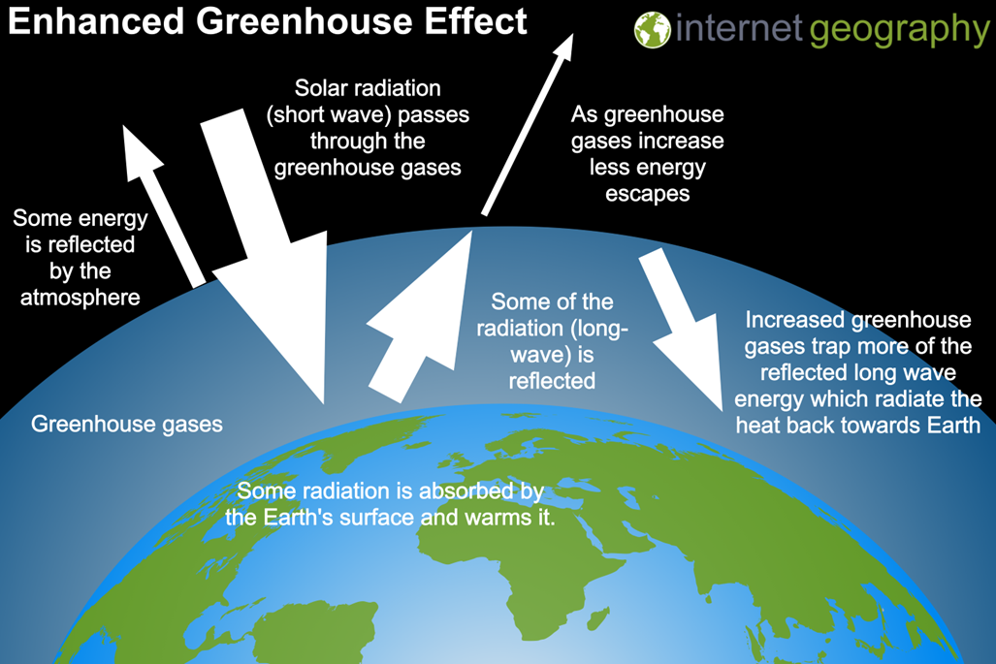
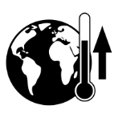
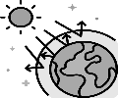
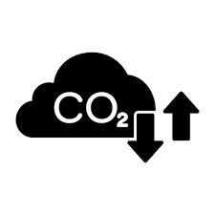
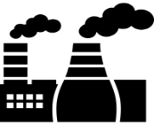
Geography – Year 10 – Climate Change
BBA
Section 1: Core Vocabulary
Vocabulary | Definition | Image
Climate change | How the average climatic conditions of the planet vary over time.
Global warming | The gradual warming of the planet associated with human activity.
Quaternary period | The quaternary period began 2.6 million years ago and extends into the present.
Milankovitch Cycles | The three ways the Earth's orbit of the Sun changes over the course of tens of thousands of years.
Greenhouse effect | A naturally occurring phenomenon that keeps the Earth warm enough for life to exist.
Enhanced greenhouse effect | The warming of the Earth’s atmosphere due to human activity increasing the layer of greenhouse gases.
Greenhouse gases | Gases in the Earth's atmosphere that trap heat, for example, carbon dioxide and methane.
Deforestation | The permanent removal of forests.
Mitigation | The action of reducing the severity of climate change, e.g. reduce the amount of fossil fuels being burned.
Adaptation | Adaptation is the modifying of lifestyles and steps taken to live with the impacts of climate change.
Section 2: Key Knowledge
Enhanced greenhouse effect Natural causes of climate change Human causes of climate change
Section 3: Case-Study/Place Knowledge
Effects of Climate Change
Rising sea levels | Crop yields | Unusual weather
Coastal areas are at greater risk of flooding and storm surges, e.g. Philippines | North America will see a 20% increase in crop yields In Africa crop yields are expected to decline | In Europe higher temperatures lead to more heatwaves Increase in droughts and forest fires in Australia
Pests and diseases | Water supply | Plants and animals
Diseases such as malaria will spread, putting 60% of Africans at risk More cases of cholera in SE Asia | Freshwater supplies in Asia are expected to decrease and affect more than 1 billion people by 2050 | Less sea ice will result in loss of birds and mammals Increase in coral reef bleaching reducing biodiversity
Orbital changes - Milankovitch cycles are variations in the tilt/orbit of the Earth around the Sun
Volcanic activity - Carbon dioxide is released into the atmosphere during eruptions.
Solar output - The radiation emitted by the Sun fluctuates. High levels of radiation = increase in temperatures.
Managing Climate Change
Mitigation | Adaptation
Alternative energy production: developing renewable energy, e.g. solar panels Carbon capture: carbon dioxide is captured from power stations and converted into a dense liquid Planting trees: afforestation which absorbs carbon dioxide through photosynthesis International agreements: countries working together to set targets, e.g. Paris 2015 | Changes in agricultural systems: farmers response to climate change by adapting their farming practice, e.g. changing types of crops they grow Managing water supply: developing water transfer schemes by moving water from area of surplus to area of deficit Reducing the risk of rising sea levels: developing coastal defences to protect areas at risk of coastal flooding
Deforestation - dioxide. When trees are cut down, less carbon dioxide will be absorbed, leading to increased concentrations in the atmosphere.
Agriculture - Increased pastoral (animal) farming leads to more methane being released into the atmosphere.
Extra support Climate change
Burning fossil fuels - When coal, oil and gas are burned, carbon dioxide is released into the atmosphere.

